Slide 1

FEDERAL UNIVERSITY OF LAFIA DEPARTMENT OF CHEMISTRY
Course code: CHM102
Course Title: General Chemistry II
Course Unit: (2 Units)
Module 1: Historical survey of the development and importance of organic chemistry, Fullerenes as fourth allotrope of carbon, Nano structures, Uses as nanotubes and Nano chemistry

Slide 2
Objectives
Historical survey of the development and importance of Organic Chemistry.
Fullerenes as fourth allotrope of carbon
Nanostructures
Uses as nanotubes
Nano chemistry

Slide 3
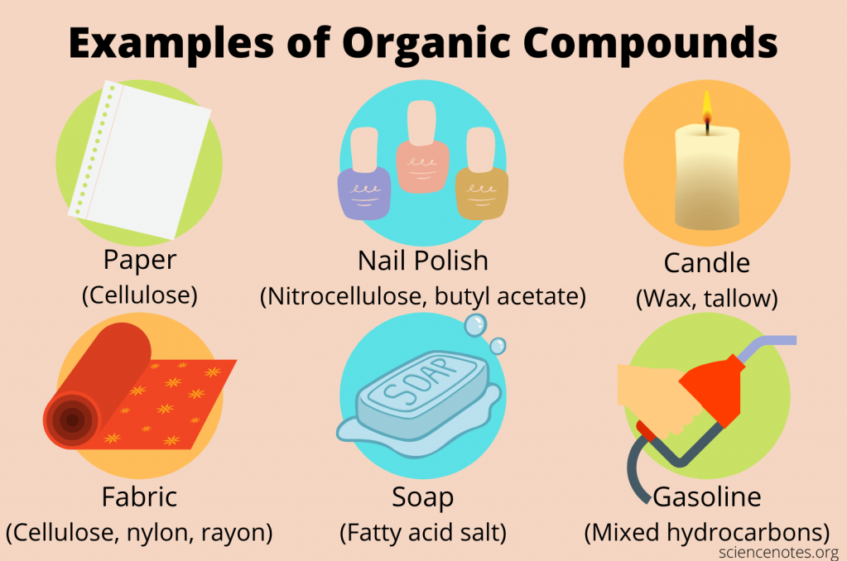
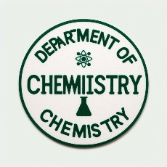
Organic chemistry is the branch of chemistry that deals with the structure, properties, reactions, and synthesis of organic compounds, which are molecules that contain carbon atoms.
Organic chemistry is one of the most diverse and dynamic fields of science, as it encompasses the chemistry of life, natural products, drugs, fuels, materials, and many other applications.

Slide 4
The history of organic chemistry
plants
animals
minerals for various purposes
However, the modern era of organic chemistry began in the late 18th and early 19th centuries, when chemists such as
Antoine Lavoisier,
Joseph Priestley,
Carl Scheele, and
Humphry Davy
…….discovered and isolated many important elements, including oxygen, hydrogen, nitrogen, carbon, chlorine, and iodine.
They also established the concepts of chemical elements, compounds, reactions, and stoichiometry

Slide 5
Major challenges in early organic chemistry was to explain the difference between organic and inorganic compounds.
Initially, it was believed that organic compounds could only be produced by living organisms, and that they possessed a vital force that distinguished them from inorganic compounds.
This idea was challenged by Friedrich Wöhler in 1828, when he synthesized urea, an organic compound found in urine, from ammonium cyanate, an inorganic salt. This was the first example of an artificial synthesis of an organic compound from inorganic materials.
Wöhler’s experiment showed no fundamental difference between organic and inorganic compounds, and that they were both governed by the same chemical laws.

Slide 6
The development of organic chemistry accelerated in the 19th century
Many new organic compounds were discovered and characterized by various methods such as
combustion analysis,
elemental analysis,
molecular weight determination,
optical activity measurement, and
spectroscopy.

Slide 7
Some of the most influential chemists are
Justus von Liebig,
August Kekulé,
Louis Pasteur,
Emil Fischer,
Jacobus van’t Hoff
Others are:
Friedrich August Kekulé von Stradonitz (who proposed the structure of benzene),
Adolf von Baeyer (who synthesized indigo dye),
Hermann Emil Fischer (who elucidated the structures of sugars and purines), and
Alfred Werner (who developed coordination chemistry).

Slide 8
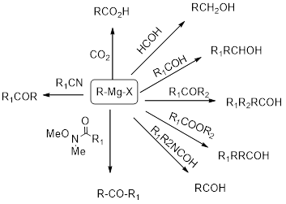
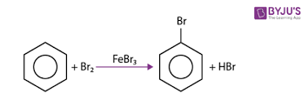
The 20th century witnessed further advances in organic chemistry
Such as the development of synthetic methods (such as Grignard reactions),
reaction mechanisms (such as electrophilic aromatic substitution),
Others are spectroscopy (such as nuclear magnetic resonance), biochemistry (such as DNA structure), polymer chemistry (such as nylon synthesis), medicinal chemistry (such as penicillin discovery), and green chemistry (such as atom economy).

Slide 9
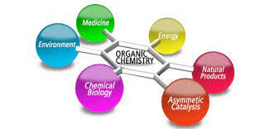
The importance of organic chemistry
Organic chemistry has contributed to the fields of biology, medicine, agriculture, energy, materials science, nanotechnology, environmental science, and more.
Organic chemistry is also a creative and challenging discipline that requires logical thinking and problem-solving skills.

Slide 10
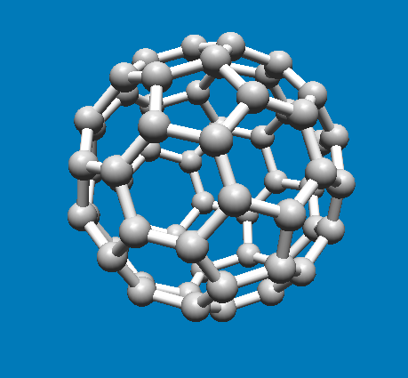
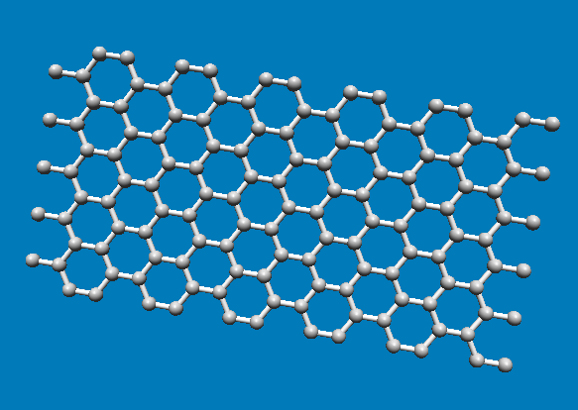
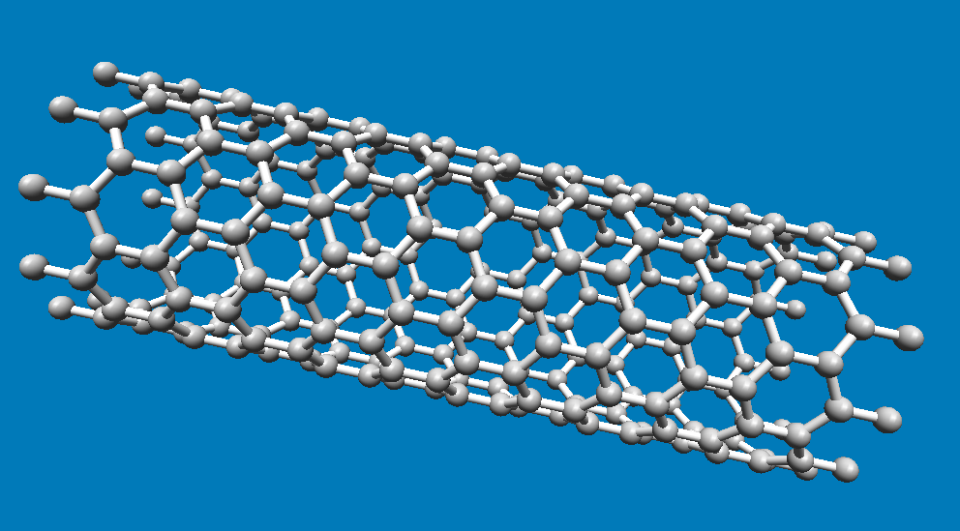
Fullerenes as fourth allotrope of carbon
Allotropy is the property of some chemical elements to exist in two or more different forms, or allotropes, when found in nature. There are several allotropes of carbon.
Fullerenes are a fourth allotrope of carbon, discovered in 1985. The most common form is called buckminsterfullerene (C60), which has a spherical shape and consists of 60 carbon atoms. It is a crystalline allotrope with good heat and electricity conductor properties.
Buckminsterfullerene
Graphite
Nanotubes

Slide 11
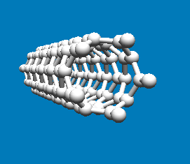
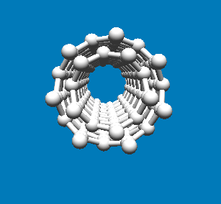
Nanostructures
CNTs are cylindrical molecules made of rolled-up sheets of single-layer carbon atoms (similar to graphene).
Single wall carbon nanotube
Multi wall carbon nanotube

Slide 12
Properties and Uses
CNTs exhibit remarkable properties:
High strength: They’re incredibly strong yet lightweight.
Electrical conductivity: They conduct electricity efficiently.
Thermal conductivity: They transfer heat effectively.
Chemical stability: They’re resistant to chemical reactions.
Uses
Materials: Creating ultra-strong, lightweight materials.
Catalysis: Enhancing chemical reactions.
Transistors: Improving electronic devices.
Sensors: Detecting various substances.
Nano inks: For printing electronic circuits.
Electrodes: In batteries and supercapacitors.
Displays, optoelectronics

Slide 13
The following are three exercises for this topic:
Match each chemist with their contribution to organic chemistry:
A) Antoine Lavoisier B) Friedrich Wöhler C) August Kekulé D) Emil Fischer E) Alfred Werner
Synthesized urea from ammonium cyanate ii) Proposed the structure of benzene iii) Discovered oxygen and established the law of conservation of mass iv) Elucidated the structures of sugars and purines v) Developed coordination chemistry
What is the difference between organic and inorganic compounds? How did Wöhler’s experiment challenge the vital force theory?
Give an example of an organic compound that has a significant impact on one of the following fields: biology, medicine, agriculture, energy, materials science, nanotechnology, environmental science, or green chemistry. Explain why it is important and how it was discovered or synthesized.

Slide 14
Thank you

